Slide 1
ARCHITECTURE
NAGARA STYLE
VS
DRAVIDIAN STYLE

Slide 2
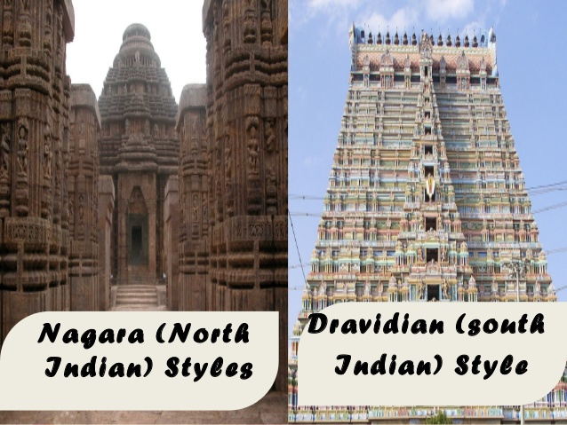
ARCHITECTURE OF EARLY MEDIEVAL PERIOD
THE DIFFERENCE IN NAGARA STYLE AND THE DRAVIDIAN STYLE OF ARCHITECTURE

Slide 3
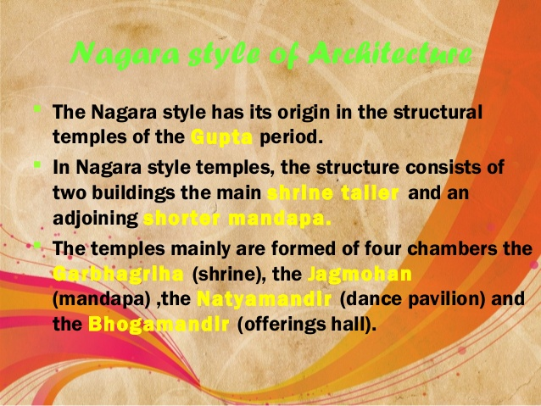
THE NAGARA STYLE

Slide 4
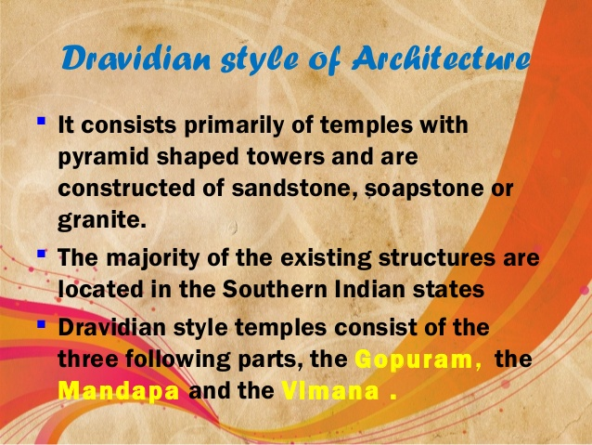
THE DRAVIDIAN STYLE

Slide 5
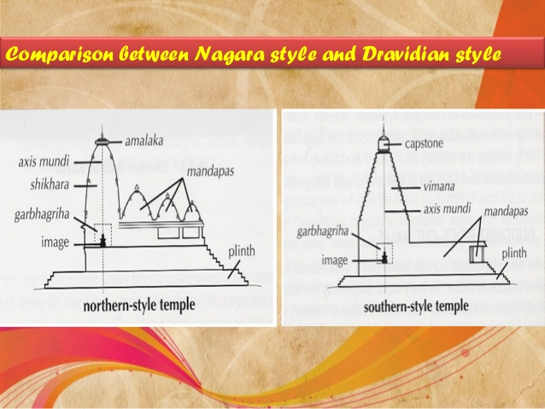
COMPARISON BETWEEN THE TWO

Slide 6
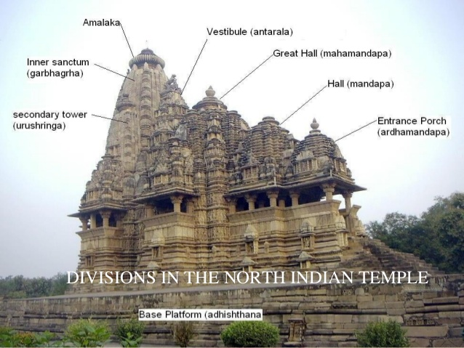
A NAGARA STYLE TEMPLE
DIVISIONS OF A TEMPLE

Slide 7
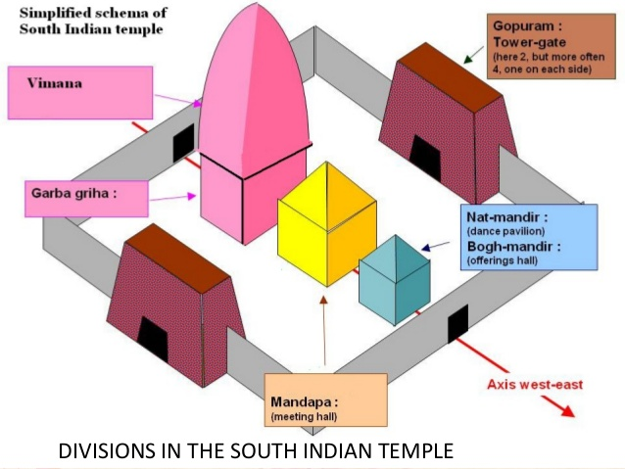
THE SOUTH INDIAN STYLE

Slide 8
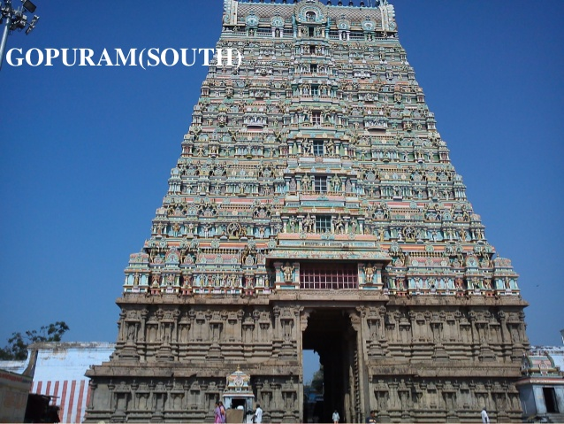
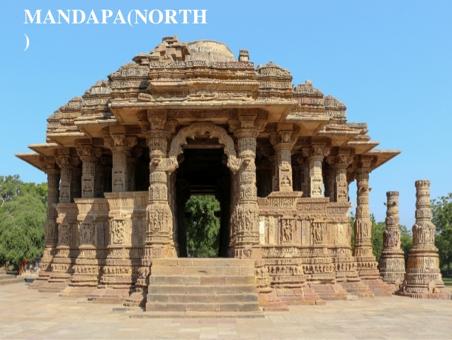
THE SHARPLY RISING TOWER VS GENTLY RISING ONE
GOPURAM (SOUTH)
MANDAPA (NORTH)

Slide 9
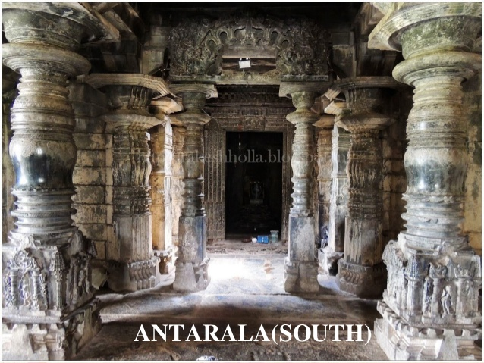
ANTRALAYA(SOUTH)

Slide 10
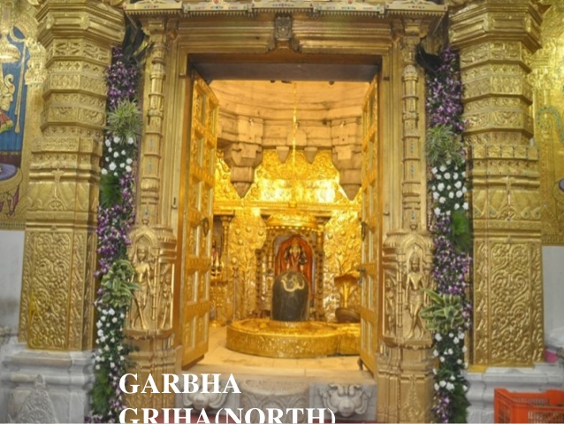
GARBAGRIHA (NORTH)

Slide 11
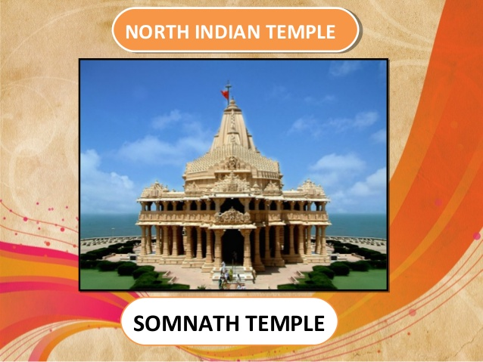
EXAMPLE- SOMNATH TEMPLE(NORTH)

Slide 12
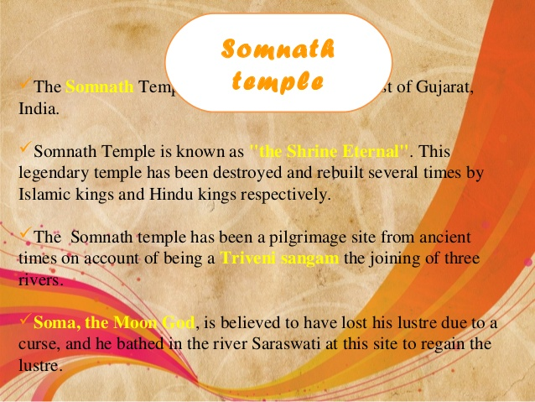

Slide 13
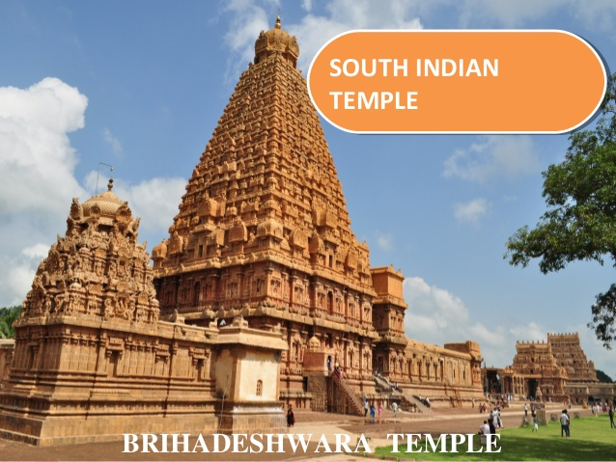
EXAMPLE-BRIHEDESHWARW TEMPLE(SOUTH)

Slide 14
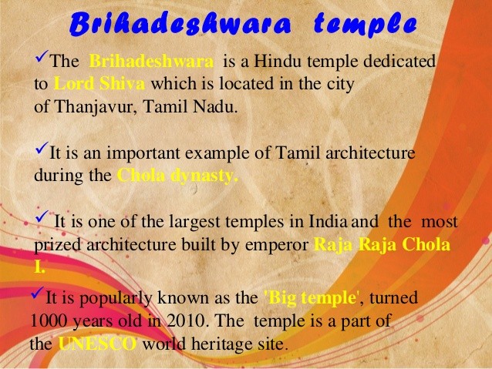

Slide 15
WORK TO BE DONE
DEFINE:-
GOPURAM
SHIKHAR
ANTRALAYA
GARBHAGRIHA
MANDAPA
VIMANA

